Slide 1
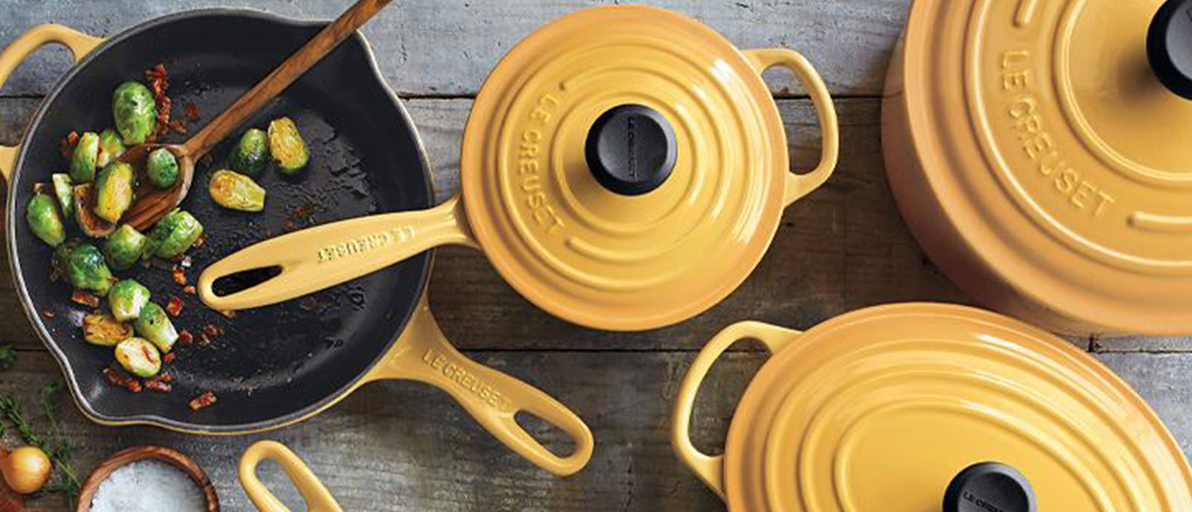

Predicting Discounts on
Lisa Sabovic

Slide 2
What is Sur La Table?
It means “On the Table” in French
The second-largest specialty cookware brand in the US
Not super affordable…
But has lots of discounted products!
Objective: let’s try to predict a discount on items of at least $100!

Slide 3
Looking at trends by: product category, country produced in, average ratings
BeautifulSoup
Scrape
Clean
EDA
Predict
R²=0.21
Over 7,600 records; most not usable; removing outliers
Isolating features that have predictive power in discounts using sklearn & statsmodels

Slide 4
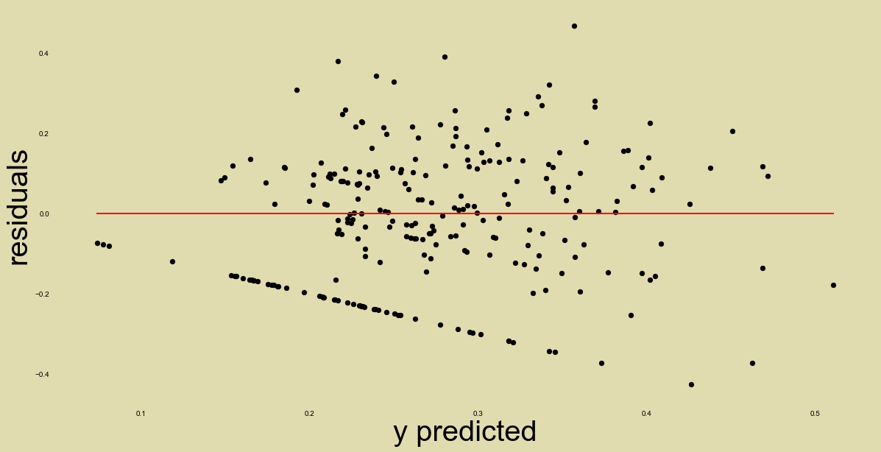
Notes:
Systematically over-predicting discounts when there doesn’t exist a discount
Under-predicting discounts when discounted value is really high (over 50%)

Slide 5
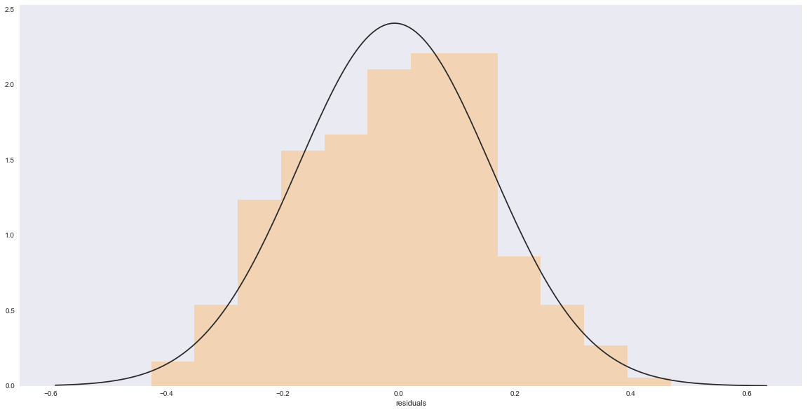
residuals
Notes:
Systematically over-predicting discounts when there doesn’t exist a discount

Slide 6
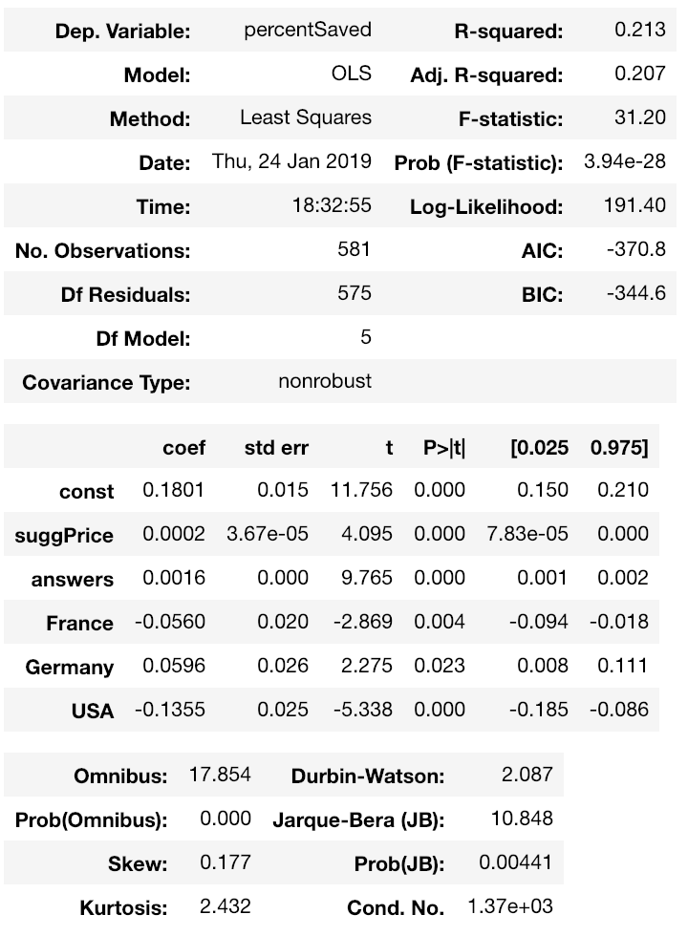
...and what does R²=0.21 tell us?
Features in this model can only explain 21.3% of variance in how much a product was discounted.

Slide 7
...and which features does this include?
As MSRP increases, so does the discount rate
As the amount of answers increases, so does the discount rate
If an item is made in either France or USA, the discount rate decreases relative to if its made in China
If an item is made in Germany, the discount rate increases relative to if its made in China

Slide 8
BeautifulSoup
Scrape
Clean
EDA
Predict
R²=0.21

Slide 9
Scrape
Clean
EDA
Predict
R²=0.21
Outliers (items valued more than 3 std from mean)
Missing data
Suggested price lower than sale price (clearly a mistake)

Slide 10
Looking at trends by: product category, country produced in, average ratings
Scrape
Clean
EDA
Predict
R²=0.21

Slide 11
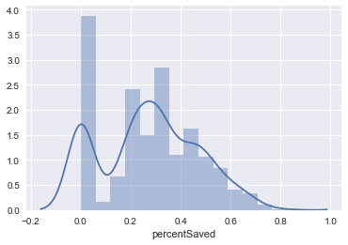
Distribution of Discounts

Slide 12
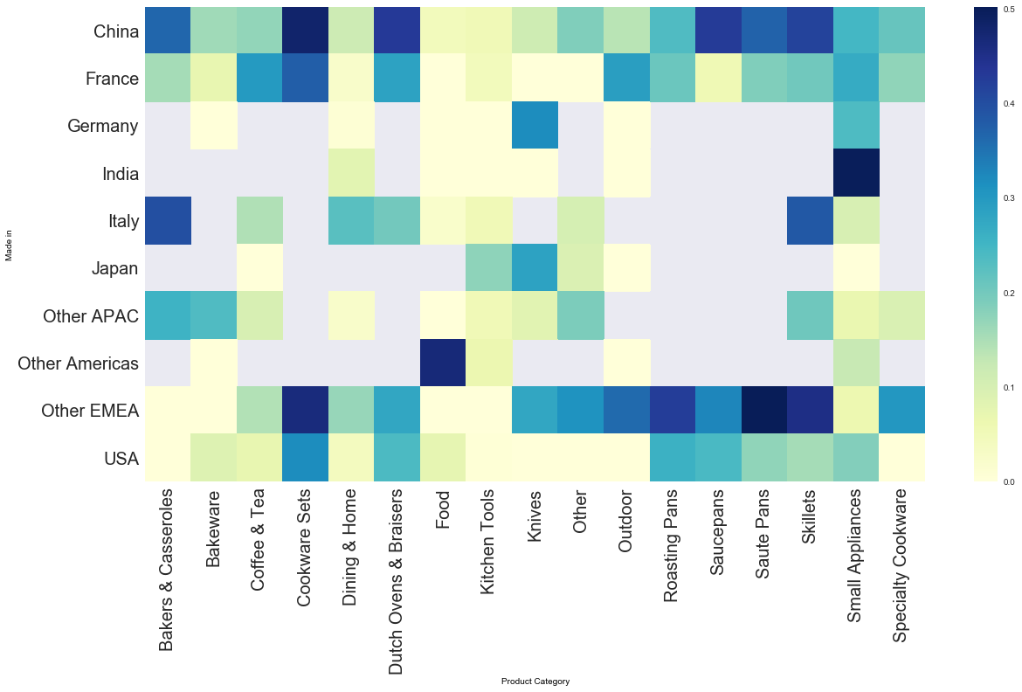
Discounts by Country and Category
Notes:
Avg discount by country and category:
Chinese made cookware sets have a high average discount rate
USA made bakers and casseroles have a very low average discount rate

Slide 13
Scrape
Clean
EDA
Predict
R²=0.21
Isolating features that have predictive power in discounts using sklearn & statsmodels

Slide 14
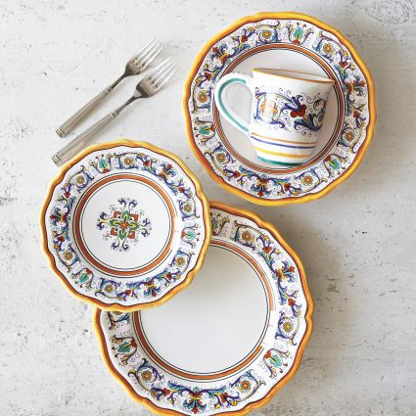
Model Methodology
Plain linear regression resulted in the highest R²
Adding polynomial features resulted in extreme overfitting
Alternated between sklearn’s LinearRegression() and statsmodels’ OLS to narrow down features using p values of coefficients
Created interaction variables, no positive change
Created standard deviation variables, no positive change
Created dummy variables for country, slight positive change!
Notes:
Avg discount by country and category:
Chinese made cookware sets have a high average discount rate
USA made bakers and casseroles have a very low average discount rate

Slide 15
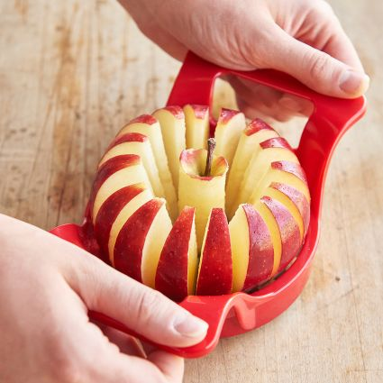
Model Takeaways
Predicted a discount when there wasn’t one
Maybe should have introduced other variables into the model (ex: Sur La Table brand vs not)
Classification might work better (will there be a discount or not)
Reform the question into: given there IS a discount, how much is it?
Notes:
Avg discount by country and category:
Chinese made cookware sets have a high average discount rate
USA made bakers and casseroles have a very low average discount rate

Slide 16
So if you want a to get a good discount at Sur La Table….
Notes:
Avg discount by country and category:
Chinese made cookware sets have a high average discount rate
USA made bakers and casseroles have a very low average discount rate

Slide 17
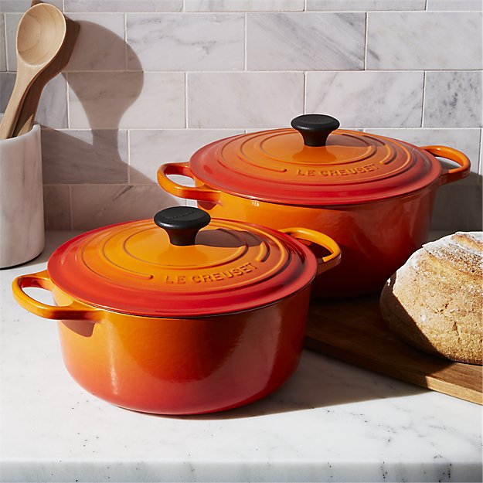
*MSRP
18%
*Answers
0.002
*Germany
6%
-6%
*France
-14%
*USA
Notes:
Avg discount by country and category:
Chinese made cookware sets have a high average discount rate
USA made bakers and casseroles have a very low average discount rate

Slide 18
Thank you!

Slide 19
Appendix

Slide 20
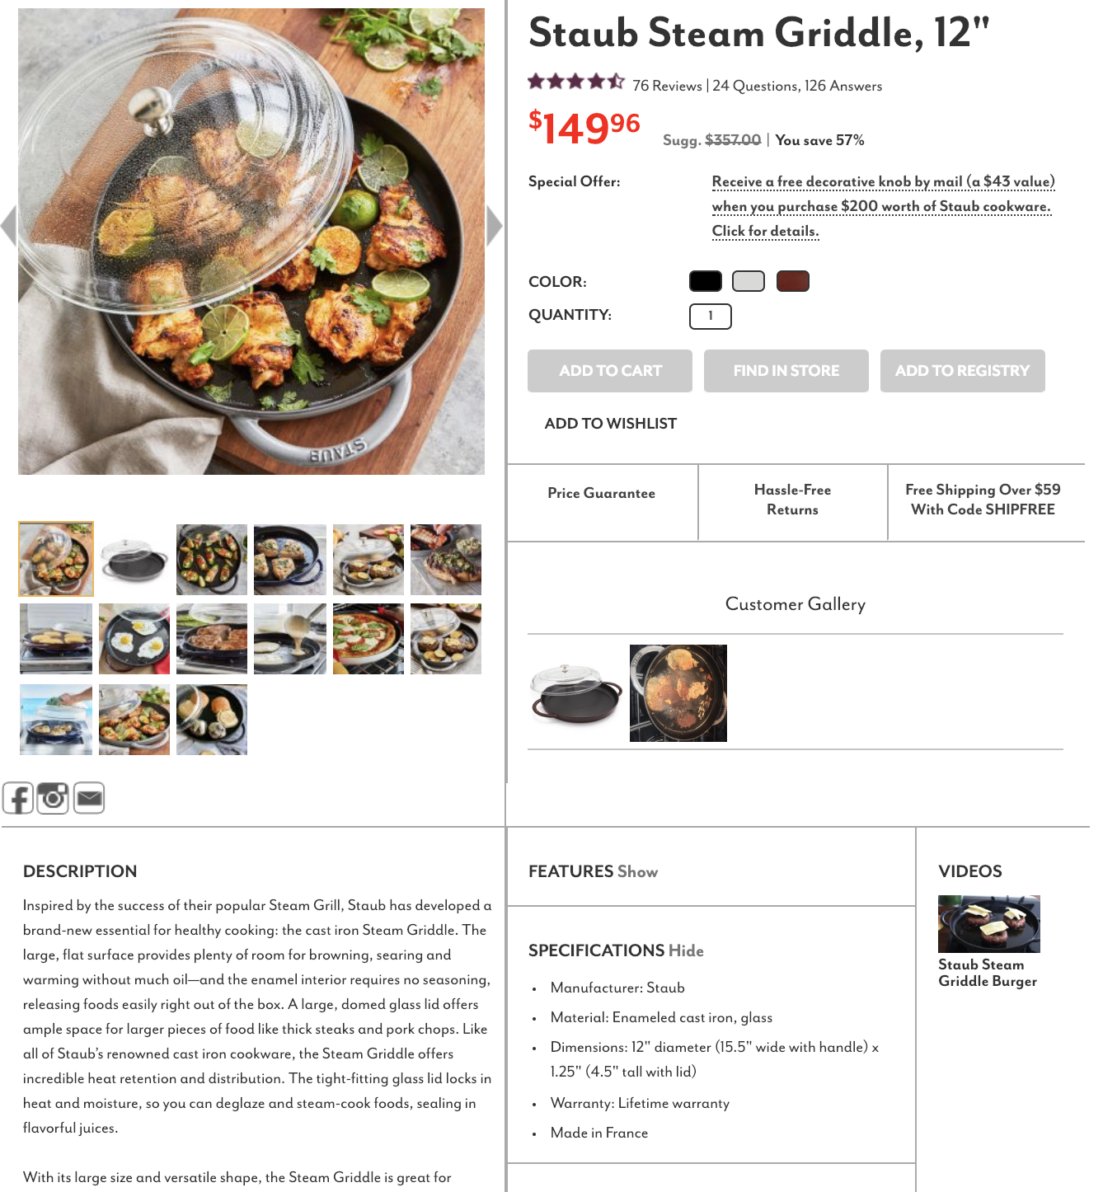
Scraping
Not pictured:
Average review
Product Category
SKU

